Slide 1
Session Types and Cake
Wen Kokke
University of Edinburgh
Supervised by Phil Wadler and J. Garrett Morris

Slide 2
First, a story.

Slide 3
This is Mary.
She loves cake.
This is John.
He loves cake too.

Slide 4
This is a store.
It sells cake.
There is only one cake left.

Slide 5
Mary and John have to race.
That’s ok. The store doesn’t mind.

Slide 6
So… Races are good sometimes!

Slide 7
And deadlocks are bad.
I’m sure we all know.

Slide 8
This is Classical Processes.

Slide 9
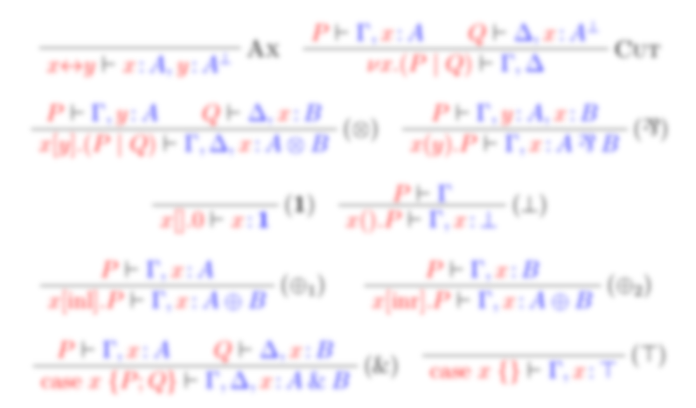
This is Classical Processes.
It’s basically classical linear logic,
typing a process calculus.

Slide 10
This is what I’ve added.

Slide 11
This is our example race.
( : Could be cake, could be disappointing.)

Slide 12
This is our example race.
( : Could be cake, could be disappointing.)

Slide 13
Who gets the cake?
( : Could be cake, could be disappointing.)

Slide 14
Mary gets the cake.
( : Could be cake, could be disappointing.)

Slide 15
John gets the cake.
( : Could be cake, could be disappointing.)

Slide 16
And so we had races, but no deadlocks. The End.

Slide 17
Thanks!

